Slide 1
Evolving Organisms with Genetic Algorithm
UE20CS302 – Machine Intelligence
Mini Project
Project Title :Evolving Organisms with Genetic Algorithm
Team No: 13
Project Guide :
Project Team with SRNs : Md Taseen Atehar PES2UG20CS191
M Manonmana Udupa PES2UG20CS181
Hrishikesh B.H PES2UG20CS144

Slide 2
Problem Statement
The objective of this Project is to simulate an organism in a hostile environment where the first generation is placed without any knowledge or guidance.
Through reinforcement learning and an application of genetic algorithm, the organisms learn to seek the beneficial ‘food’ and avoid the ‘poison’ through the generations.
Notes:
Provide a basic introduction of the project and also an overview of scope it entails.
Set the context.

Slide 3
Application and Uses
The project demonstrates a method that can be used to train organisms in various simulations, for example microbial simulations or simulations of an ecosystem.
The prototype presented proves the working of this model and can be further trained and applied to various simulations as required.
Notes:
Provide a basic introduction of the project and also an overview of scope it entails.
Set the context.

Slide 4
High level Architecture
Using the basic Genetic Algorithm structure i.e., we first randomly create a population and allow them to explore and learn the environment.
Out of these organisms the fitter ones have higher probability of caring their genes to the next generation.
The fitter ones are calculated according to the health of the organism which is the amount of food and poisoned they’ve consumed.
The next generation are populated using a basic crossover and may undergo mutation to produce fitter organisms compared to the previous generation
Notes:
Provide a basic introduction of the project and also an overview of scope it entails.
Set the context.

Slide 5
Literature Survey
Title of the paper | Year of Publication | Journal/Conference Name | Advantages | Limitations
Research on an Improved Ant Colony Algorithm-Fusion with Genetic Algorithm for Route Planning | 2020 | ITNEC48623 | Efficiency is improvised based on the round trip calculated | Efficiency is low due to low local optimum
A Hybrid Genetic Algorithm Based on Information Entropy and Game Theory | 2020 | 10.1109/ACCESS.2020.2971060 | Multi group genetic operations are performed in parallel | Time complexity is high
Self-Adaptive Hybrid Extreme Learning Machine for Heterogeneous Neural Networks | 2020 | 10.1109/IJCNN48605.2020.9207608 | Evolve homogenous networks to heterogenous networks | Time complexity is high
Notes:
Provide summary of Phase – 1.
Include the suggestions and improvements made.

Slide 6
Literature Survey
Title of the paper | Year of Publication | Journal/Conference Name | Advantages | Limitations
Energy-Efficient Routing Using Genetic Algorithm in Cluster-Based Wireless Sensor Networks | 2019 | 10.1109/VTCFall.2019.8891489 | The performance gap grows as the sensor field increases. Performs the CH selection and the route discovery in one phase. | Performance decreases when the sensor field is small. Random initialization of CP may create a cyclic path.
Deep Reinforcement Learning using Genetic Algorithm for Parameter Optimization | 2019 | arXiv:1905.04100v1 | GAs find good parameter values leading to better task performance, faster. Finds learning algorithm parameters that needs fewer epochs. | Contains Gaussian noise which needs to be reduced.
Applying m-Mutation Operator in Genetic Algorithm to Solve Permutation Problems | 2019 | 10.1109/ICSCAN.2019.8878867 | Genetic algorithm solves permutation problem by quickly searching the search space. | Traditional crossover operators cannot be used to perform crossover of permutation problem solutions .
Notes:
Provide summary of Phase – 1.
Include the suggestions and improvements made.

Slide 7
Literature Survey
Title of the paper | Year of Publication | Journal/Conference Name | Advantages | Limitations
A hybrid posture detection framework: Integrating machine learning and deep neural networks | 2021 | JSEN.2021.3055898 | Effective in larger dimensions, has higher training period accuracy is good | As the dimensions get larger data processing gets slower
Shortcut Learning in Deep Neural Networks | 2020 | https://doi.org/10.1038/s42256-020-00257-z | Stochastic learning and NLP makes the training faster | Too many convolutions decrease the performance
Path Loss Prediction Based on Machine Learning Techniques: Principal Component Analysis, Artificial Neural Network, and Gaussian Process | 2020 | http://dx.doi.org/10.3390/s20071927 | path loss is mathematically expressed using a linear log-distance function | Multi dimensional regression reduces performance
Notes:
Provide summary of Phase – 1.
Include the suggestions and improvements made.

Slide 8
Proposed Approach
We create an environment which contains n Organisms and a fixed amount of foods and poisons scattered randomly
The Organisms have a dna which decides how much they are attracted to or repelled by to the food and poison.
The Organisms learn through the sacrifice of their ancestors to avoid poison and seek food.
The future generations are based on Genetic algorithm with roulette wheel selection to pick the healthiest organisms as parents.
Notes:
Provide summary of Phase – 1.
Include the suggestions and improvements made.

Slide 9
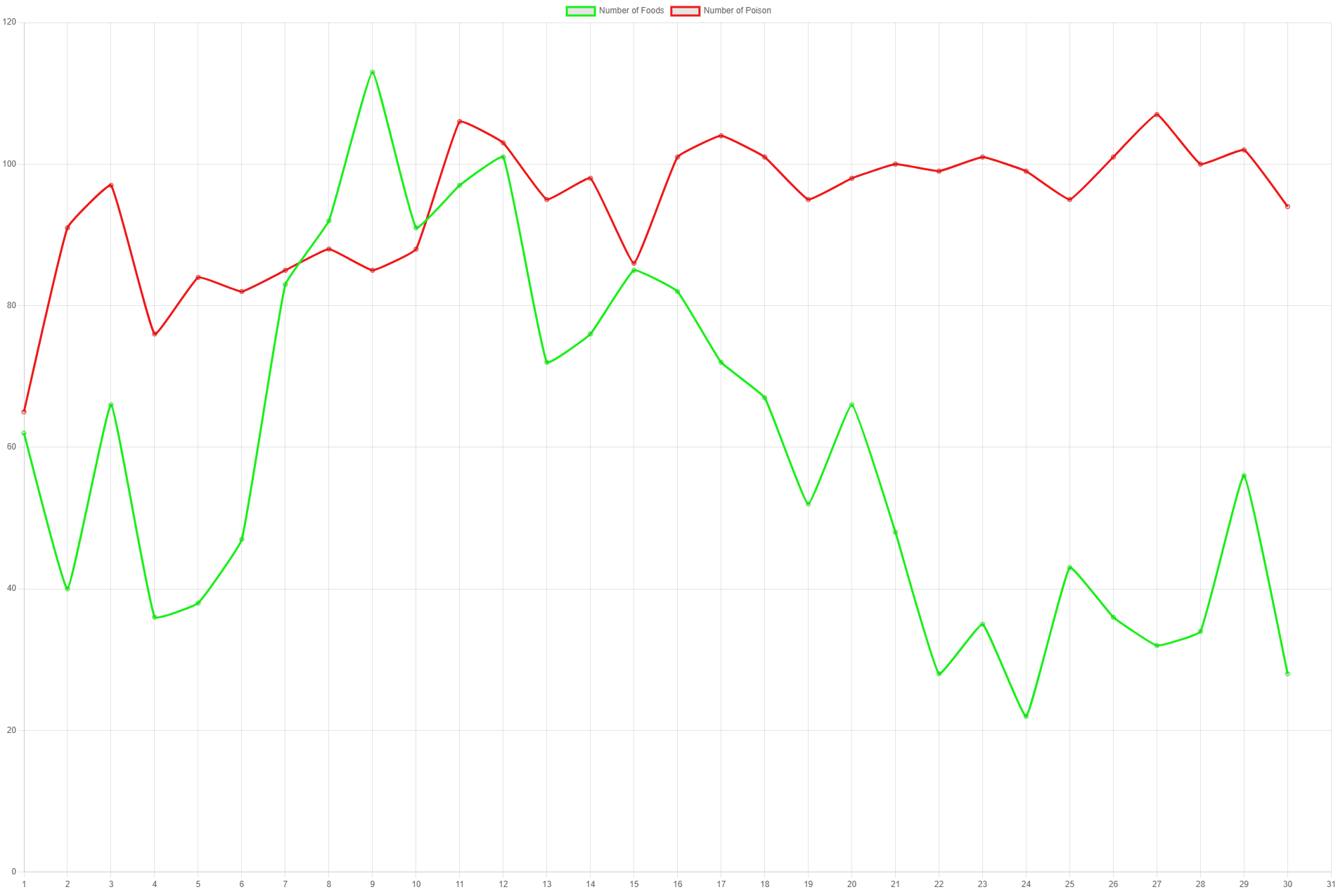
Results and Discussion
Notes:
Provide summary of Phase – 1.
Include the suggestions and improvements made.

Slide 10
Results and Discussion
As the number of generations increases , the organisms learn to avoid poison and consume only food.
From the graph ,we can see that the amount of food left at the end of a cycle decreases each generation and the amount of poison in the environment increases.
From this we infer that the organisms have learned to avoid poison and seek food in few generations.
Notes:
Provide summary of Phase – 1.
Include the suggestions and improvements made.

Slide 11
Refrences
https://nathanrooy.github.io/posts/2017-11-30/evolving-simple-organisms-using-a-genetic-algorithm-and-deep-learning/
https://www.researchgate.net/publication/309770246_A_Study_on_Genetic_Algorithm_and_its_Applications
Notes:
Provide summary of Phase – 1.
Include the suggestions and improvements made.

Slide 12
Thank You
☺

